Slide 1
杂项

Slide 2
Charts
图表

Slide 3
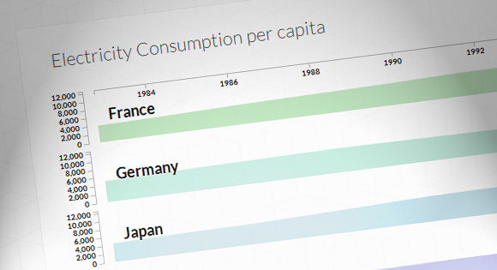
Multiple Area Charts with D3.js
http://tympanus.net/codrops/2012/08/29/multiple-area-charts-with-d3-js/

Slide 4
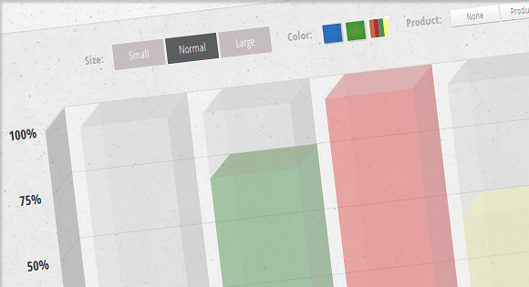
Animated 3D Bar Chart with CSS3
http://tympanus.net/codrops/2012/05/21/animated-3d-bar-chart-with-css3/

Slide 5
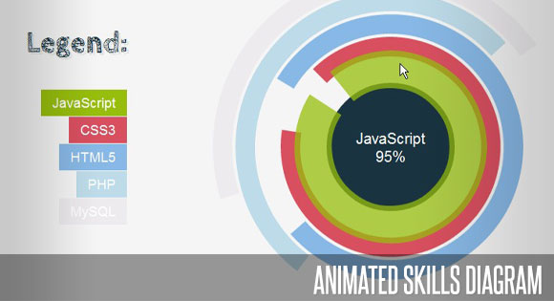
Animated Skills Diagram with Raphaël
http://tympanus.net/codrops/2011/04/22/animated-skills-diagram/

Slide 6
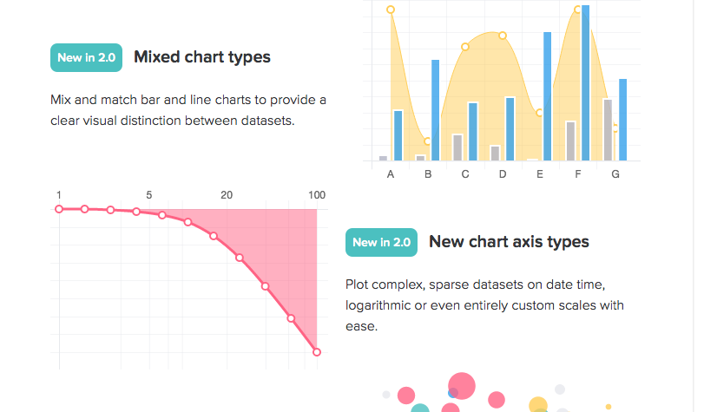
Chart.js
https://github.com/chartjs/Chart.js

Slide 7
地图
map

Slide 8
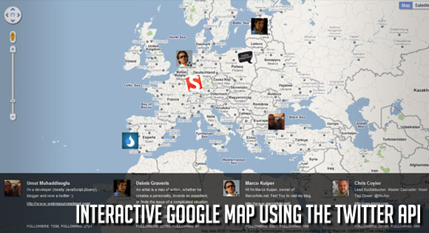
Interactive Google Map using the Twitter API
Filter Functionality with CSS3
http://tympanus.net/codrops/2011/04/13/interactive-google-map/

Slide 9
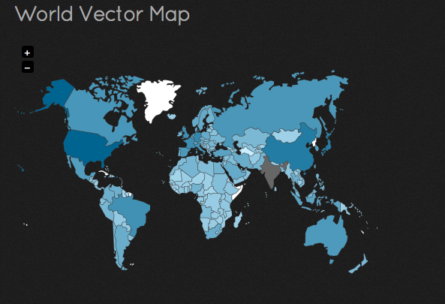
jQuery Vector Maps
Filter Functionality with CSS3
http://jqvmap.com/

Slide 10
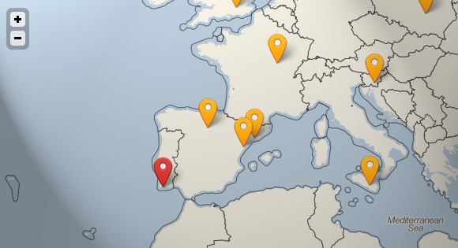
Real-Time Geolocation Service with Node.js
Filter Functionality with CSS3
http://tympanus.net/Tutorials/RealtimeGeolocationNode/

Slide 11
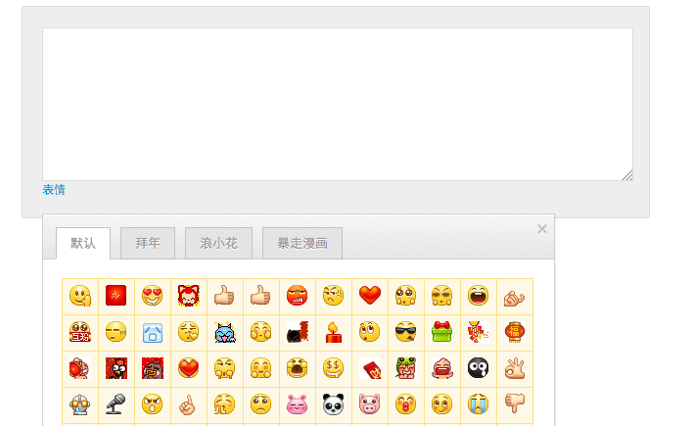
微博分享评论表情
Filter Functionality with CSS3
http://js.itivy.com/jiaoben2009/index.html

Slide 12
简历

Slide 13
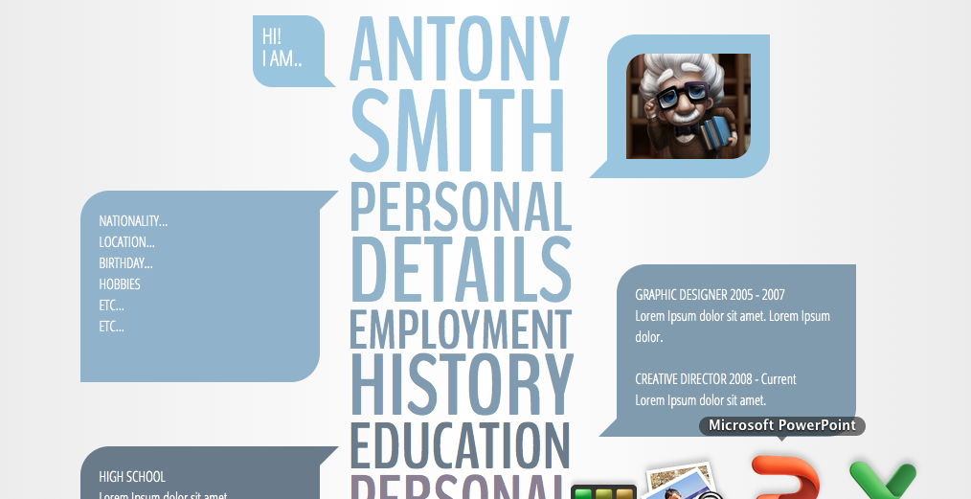
Pimp Your Tables with CSS3
http://codepen.io/SaraSoueidan/full/pdEec

Slide 14
换肤

Slide 15
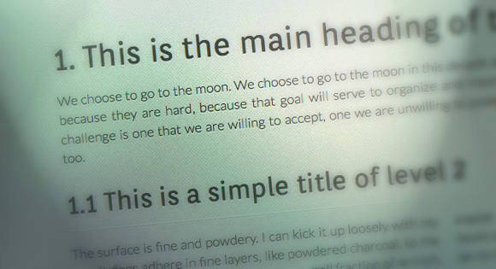
Heading Set Styling with CSS
http://tympanus.net/codrops/2012/11/02/heading-set-styling-with-css/

Slide 16
Grid

Slide 17
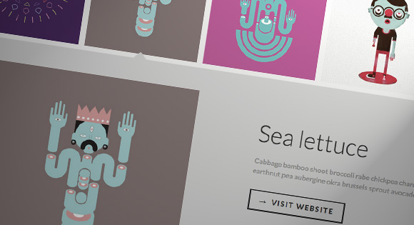

Thumbnail Grid with Expanding Preview
http://tympanus.net/codrops/2013/03/19/thumbnail-grid-with-expanding-preview/

Slide 18
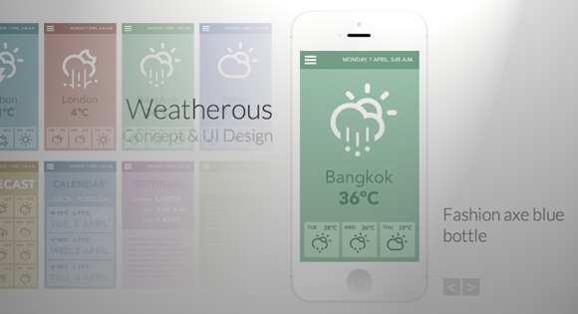
App Showcase with Grid Overlay
Filter Functionality with CSS3
http://tympanus.net/codrops/2013/04/01/app-showcase-with-grid-overlay/

Slide 19

Filter Functionality with CSS3
Filter Functionality with CSS3
http://tympanus.net/codrops/2012/01/09/filter-functionality-with-css3/

Slide 20
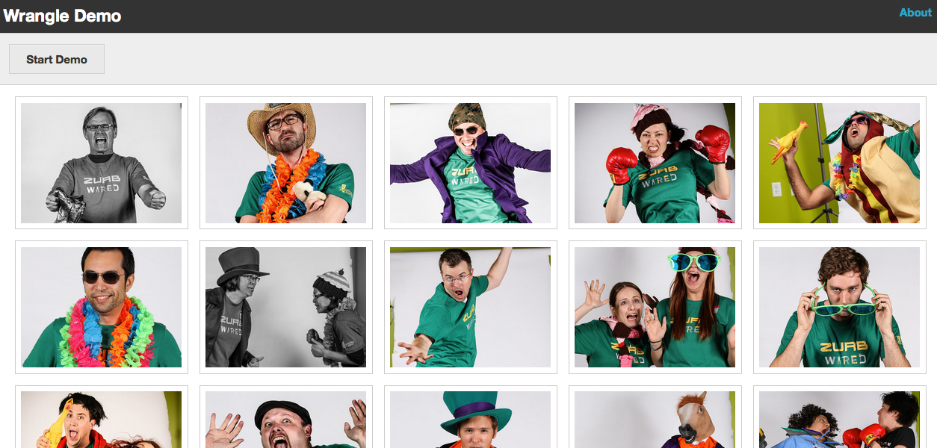
Wrangle
http://zurb.com/playground/wrangle-jquery-plugin

Slide 21
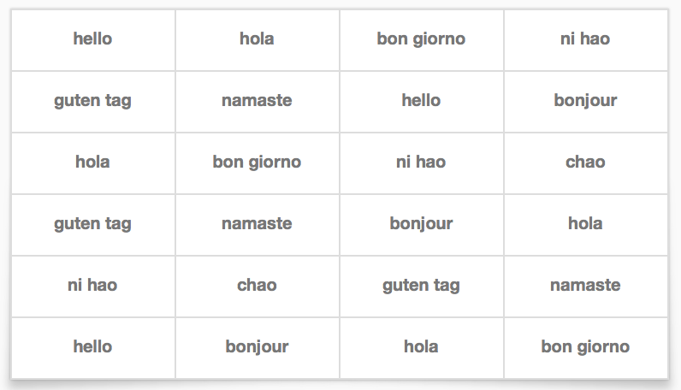
Champagne.js
http://freshtilledsoil.github.io/champagne/

Slide 22
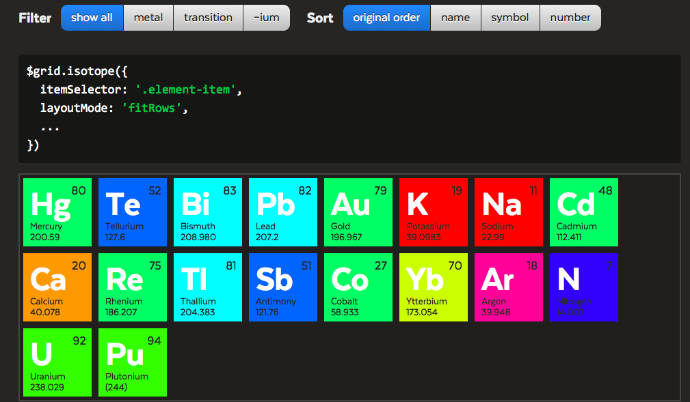
Isotope
http://isotope.metafizzy.co/index.html

Slide 23
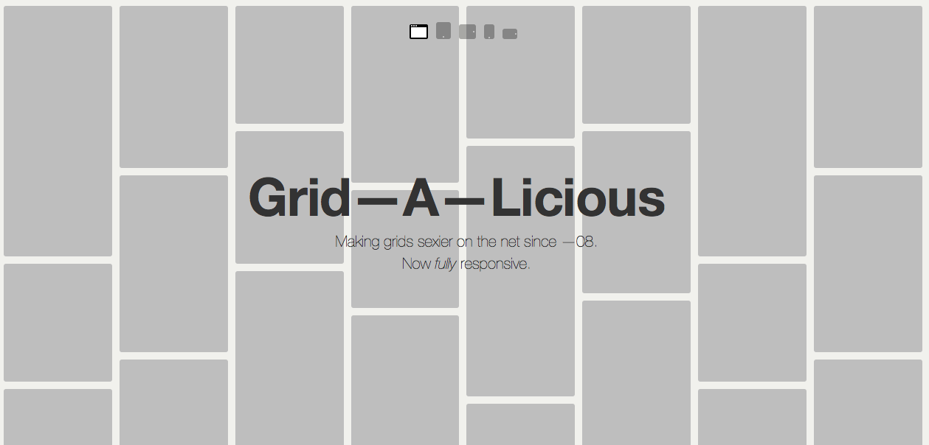
Grid—A—Licious
http://suprb.com/apps/gridalicious/

Slide 24
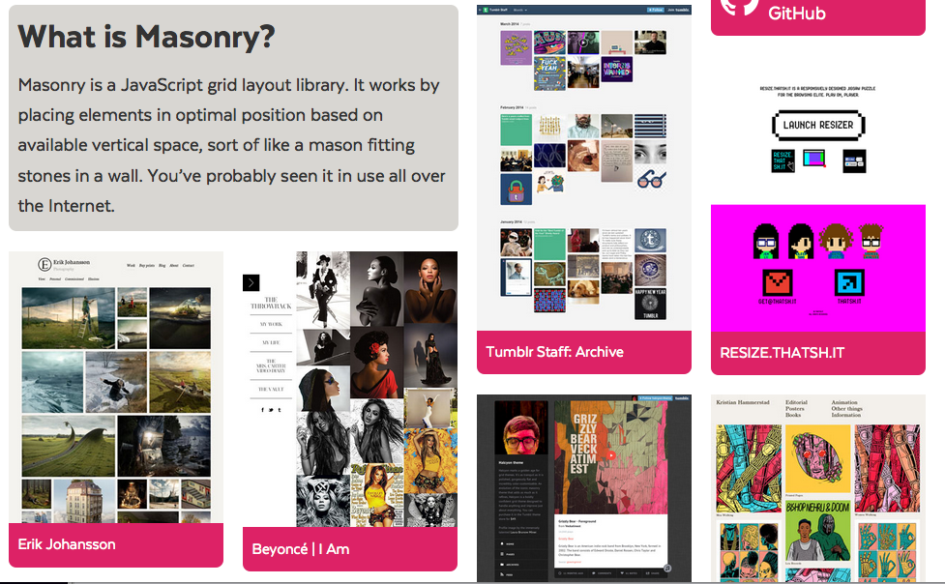
Masonry
http://masonry.desandro.com/

Slide 25
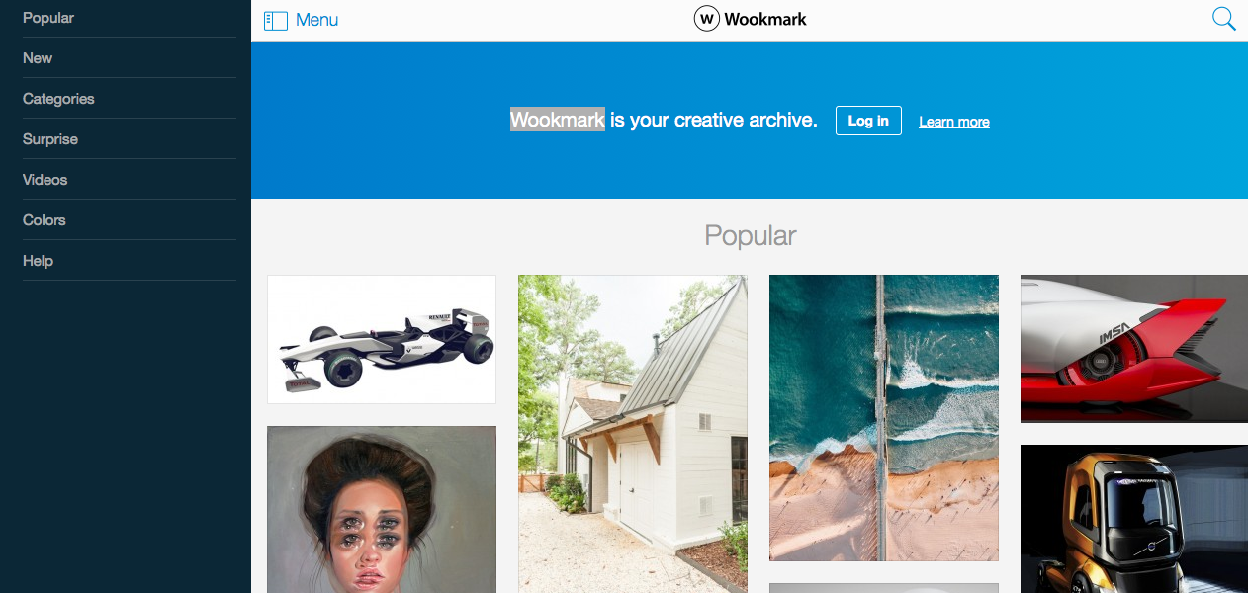
wookmark
http://www.wookmark.com/

Slide 26
Font
字体

Slide 27

Creative Web Typography Styles
http://tympanus.net/codrops/2012/09/12/creative-web-typography-styles/

Slide 28

Techniques for Creating Textured Text
http://tympanus.net/codrops/2013/12/02/techniques-for-creating-textured-text/

Slide 29
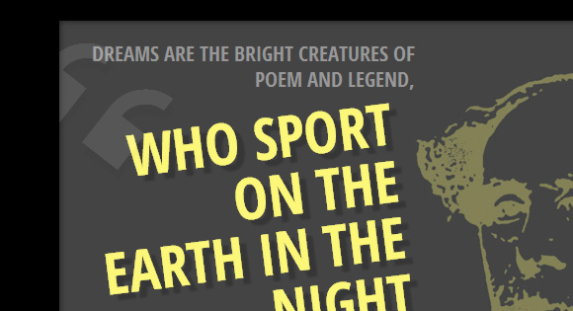
Modern Block Quote Styles
http://tympanus.net/codrops/2012/07/25/modern-block-quote-styles/

Slide 30

Rotating Words with CSS Animations
http://tympanus.net/codrops/2012/04/17/rotating-words-with-css-animations

Slide 31

Experiments with background-clip: text
http://tympanus.net/codrops/2011/12/12/experiments-with-background-clip-text/

Slide 32
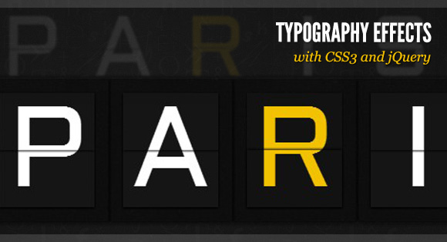
Typography Effects with CSS3 and jQuery
http://tympanus.net/codrops/2011/11/28/typography-effects-with-css3-and-jquery/

Slide 33
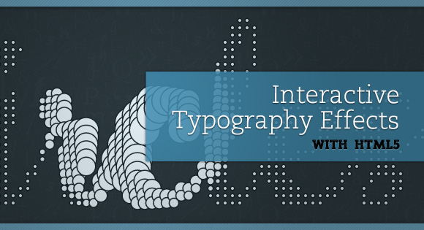
Interactive Typography Effects with HTML5
http://tympanus.net/codrops/2011/11/09/interactive-html5-typography/

Slide 34
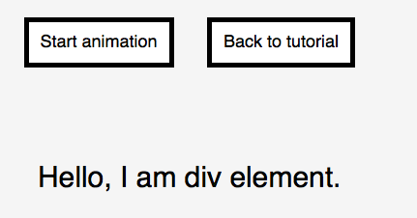
Text animation with TweenMax
http://bassta.bg/2013/05/text-animation-with-tweenmax/

Slide 35
Accordion

Slide 36
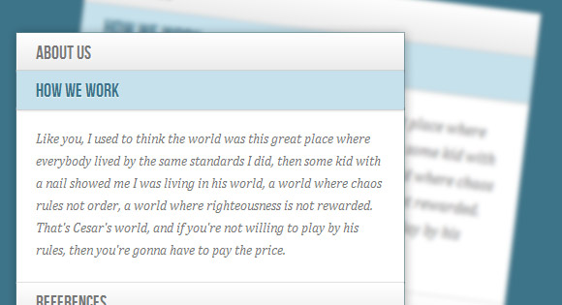
Accordion with CSS3
http://tympanus.net/codrops/2012/02/21/accordion-with-css3/

Slide 37

Elegant Accordion with jQuery and CSS3
http://tympanus.net/codrops/2010/04/26/elegant-accordion-with-jquery-and-css3/

Slide 38
页面布局

Slide 39
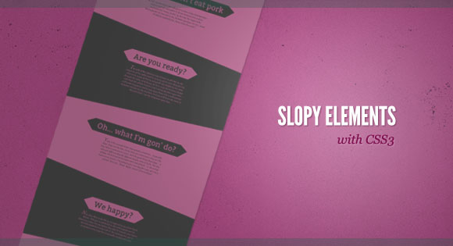
Slopy Elements with CSS3
http://tympanus.net/codrops/2011/12/21/slopy-elements-with-css3/

Slide 40
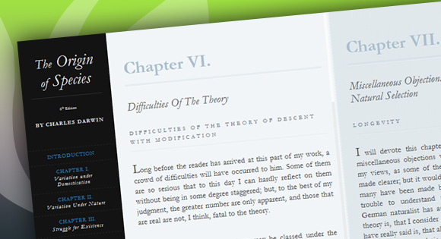
Responsive Horizontal Layout
http://tympanus.net/codrops/2012/04/02/responsive-horizontal-layout/

